Slide 1
From regulations and standards to architecture
Huib van Nieuwenhuijze (TNO)
CIRPASS-2 Coordinator
February 5, 2025

Slide 2
Disclaimer
The information provided in this presentation is for information purposes only.
The CIRPASS-2 consortium partners are not responsible for any damage that could result from making use of this information.
The information provided should not be interpreted as representing the views of CEN/CENELEC JTC 24 nor of the European Commission.

Slide 3
Notes:
Shown by Alexandru and Sotirios

Slide 4
JTC-24 and EU-funded projects
European Commission
Provides input & feedback
> 100 projects
> 100M€ funding
CEN/CLC JTC-24
Industrial Test-beds
(TRL 4 – 9)
Draft standards
Input from industry and societal stakeholders
Input from industry and societal stakeholders
Notes:
Cirpass is focused completely on DPP’s, other projects are often broader
As we talking continuously with industry, we gain agility and short feedback loops
Easy to use and low to no barrier for entry
The stakeholders overlap to a large degree
Very, very many industry initiatives exist, showing that business value beyond compliance is perceived
We are building an infrastructure to build new business models on

Slide 5
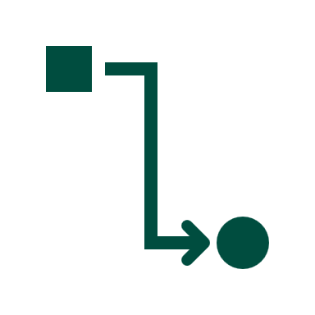
CIRPASS-2 Architecture process
ESPR
Audience: Lawyers, Policymakers, Industry, Academics
USER STORIES
Audience: Policymakers, Industry, Developers
TECHNICAL REQUIREMENTS Audience: Developers
REFERENCE ARCHITECTURE Audience: Developers
DPP SYSTEM Audience: Industry, Developers, DPP users
CIRPASS-2 pilots
Read the user stories: Project results – Cirpass2
Notes:
The user stories are strongly influenced by industry
Very many possible user stories have been identified which could produce additional value

Slide 6
Is the DPP system a data space?
What is a dataspace (DSSC.eu)?
“Interoperable framework, based on common governance principles, standards, practices and enabling services, that enables trusted data transactions between participants.”

Slide 7
Is the DPP system a data space?
Common governance principles:
- Parts from the EC / acts and regulations
- Semantics are formalized in CIRPASS-2
What is a dataspace (DSSC.eu)?
“Interoperable framework, based on common governance principles, standards, practices and enabling services, that enables trusted data transactions between participants.”
Interoperability:
CIRPASS2 looks at the entire system
Transactions:
From acts and regulations
From the user stories
Services:
CIRPASS2 describes what is necessary
(and some ‘nice to haves’)
Participants:
- Defined in the ESPR and Delegated Acts
Common governance principles:
Access rights are defined in the Delegated Acts
Access control mechanism is proposed by CIRPASS2

Slide 8
The DPP using data space terminology
Regulations will specify:
Data providers, Data consumers, (basic) Data products
Topics for the CIRPASS-2 architecture track:
Service specifications
Applicable standards, interactions, implementation considerations
Identity and access management
Trust and data sovereignty
Including abuse mitigation
Decentralization versus centralization

