Slide 1
CIRPASS-2
Digital Product Passports
WP-3: Lighthouse Pilots
Nikolaos Saklampanakis | Fujitsu
6-7 February | Hague

Slide 2
Disclaimer
The information provided in this presentation is for information purposes only.
The CIRPASS-2 consortium partners are not responsible for any damage that could result from making use of this information.
The information provided should not be interpreted as representing the views of CEN/CENELEC JTC 24 nor of the European Commission.

Slide 3
CIRPASS-2 Objectives: Real world insights for developing DPP System​
Deploy and validate at scale and in real-life setting Digital Product Passports in four target market sectors​
Focus on B2B activities that promote circularity​
Support the ongoing CEN/CENELEC standardisation work​
Demonstrate cross-pilot interoperability​
Provide support to SMEs in their uptake of DPPs. Support the deployment of DPP-as-a-Service​
Support the deployment and adoption of DPPs by other sectors targeted by upcoming European regulations and beyond​

Slide 4
Environmental & Economic sustainability
Many DPP-like solutions in the past to address business needs:
Material Traceability
Supply chain management
Tracing genuine products and more…
EU DPP: Aims to enable circular economies via decentralized, interoperable DPP information repositories
Business needs and Compliance obligations converge
Enhance environmental sustainability by enabling novel business models
Notes:
Being compliant with DPP regulation should not hinder B2B / added value use-cases to make DPPs economically viable. Enable companies to be compliant while unlocking novel business models . Environmental sustainability requires economic sustainability and DPP envisions to unlock new business models.

Slide 5
Cross-industry & cross-market DX for sustainability
IOXIO, Kezzler, EON, atma.io & circular.fashion, TripleR, Scantrust
Arcelik, DDCC & ZWEI, Whatt.io, OBADA/TBS, EcoWise
Textile
Electronics
Michelin
Cobuilder
Tyres
Construction Material

Slide 6
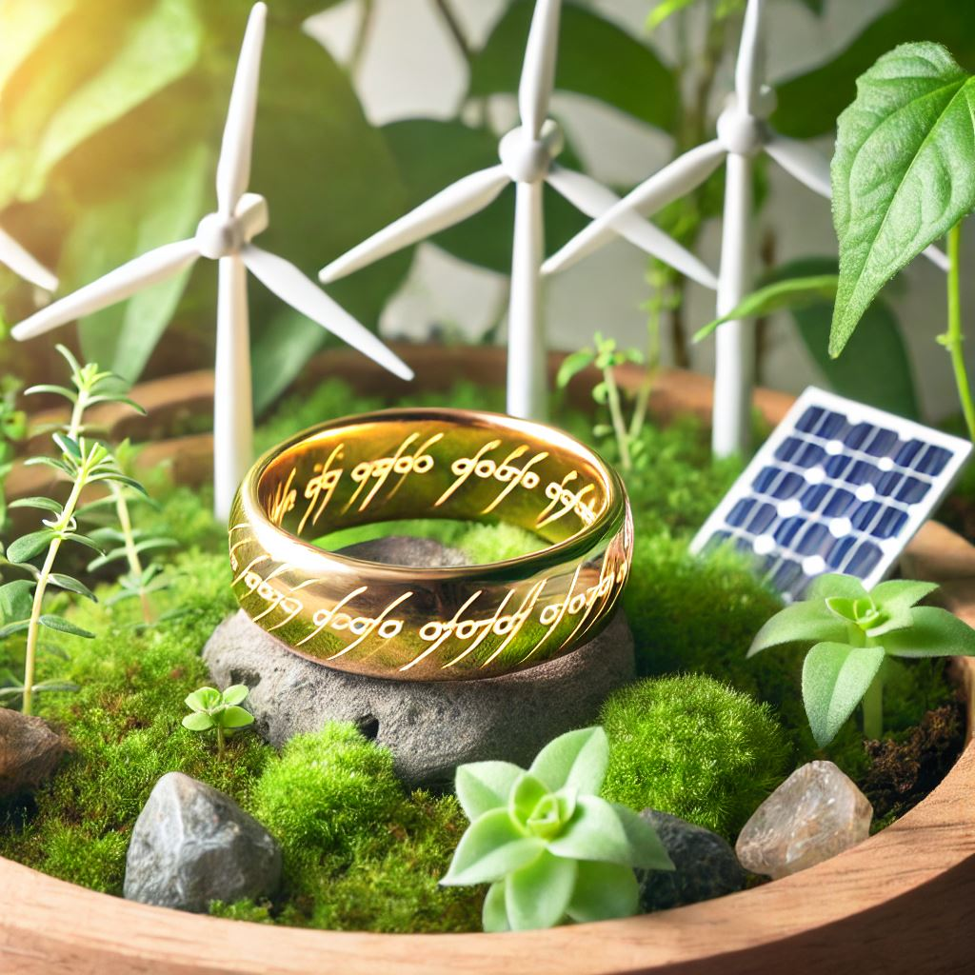
13 Pilots of power in Cirpass-2… One EU DPP System to rule them all!
DX for a single org is already challenging
DPP is pushing the transformation stream of whole value-chains cross-sector
CIRPASS-2 aims for the aligned DX of 13 business-ecosystems in 4 different market sectors
A LOT of work on alignment, setting common goals, commonly accepted methods between Pilot ecosystems
Notes:
With ESPR as compass, we are working looking beyond compliance: DPP Pilot systems should support the business of the value-chains they support. Pilots and ecosystems go beyond the mandatory use-cases and approaches, to ensure business goals are also achieved. Say a few words on challenges: * Not all ecosystems started from the same level of maturity
Difference per market sector
Different technical and organizational approaches
Different product categories – different requirements
Say a few things about how alignment and goals are achieved:
Surveys with responses to build common knowledge base between pilots
In person workshop performing assessment and brainstorming interoperability challenges
Iterative approaches, asynchronous collaboration and regular synchronization and exchanges, while enabling sector / topic specific sub-task groups

Slide 7
Methodology to foster collaboration
Surveys
Architecture & development approaches
Regulatory requirements (ESPR), e.g. Product Identifiers used, Data carriers, standards followed and more
Technical aspects, e.g. Data models, data formats, IAM
Legal barriers
Reflection on outcomes of CIRPASS, e.g. DPP User-Stories
In-person brainstorming workshop for interoperability challenges
Iterative sessions on the results
Outcome paves the way for multiple tasks over the project

Slide 9
CIRPASS-2 : Summary​
Call: DIGITAL-2023-CLOUD-DATA-04 -DIGIPASS - Digital Product Passport​
EU Agency: HaDEA​
Budget: 12,558 million euros (50% funding rate. 6 million euros requested funding)​
Type of project: Innovation Action​
Coordination: CEA​
Number of Partners: 49
Project duration: May 2024 – April 2027​

Slide 10
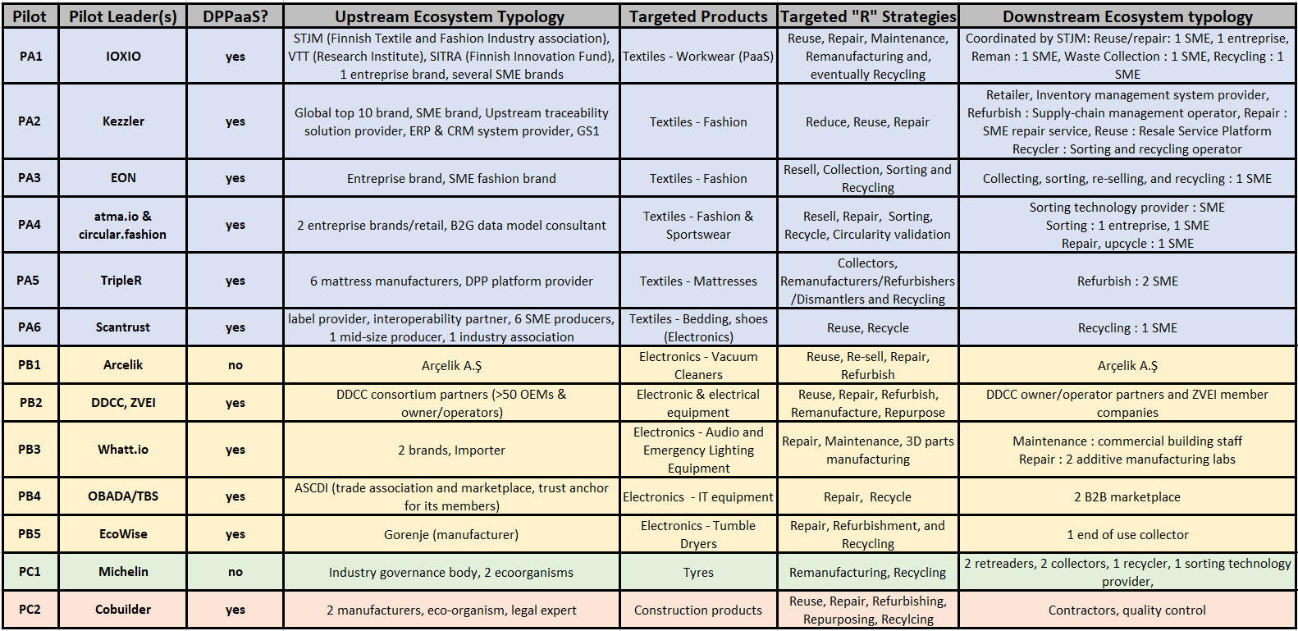
CIRPASS-2 Lighthouse Pilot Ecosystems (13)
Notes:
This slides summarizes the 13 pilots.
First column is the internal pilot code (not interesting).
Second column is the company leading the pilot.
Third column refers to whether or not the pilot leader is potentially a DPP-as-a-Service solution provider. Note that there are two special cases: Arcelik who intend to create DPPs themselves, and Michelin which will involve an industry association and is currently investigating how to set up the data space.
Fourth & seventh columns are the typology of upstream & downstream ecosystem partners, respectively.
Fifth is the target products. Note also that many pilots are from product sectors which are not the immediate focus of legislation (tyres, mattresses, electrical and electronic equipment), showing the willingness of certain to explore potential business benefits of the DPP.
Sixth column refer to the 9R Framework.

Slide 11
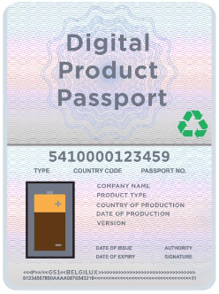
What problem are we trying to solve?​
Problem #1
“How can all industries agree on a common DPP system that is compliant to the requirements of future regulations and that is capable of supporting the massive issuing of DPPs in 2027 (Battery Regulation)?”
DPP
This is the primary focus of CIRPASS-2
Organisation
Organisation
Organisation
Organisation
Organisation
Economic Operator
User
Organisation
Raw Materials
Processed Materials
Use
Subcomponent Production
Component Production
Assembly
Market placement
Repair Remanufacture Recycle

Slide 12
What problem are we trying to solve?​
Problem #2
“How can all industries agree on an extensible and flexible DPP system capable of supporting beyond-mandatory data exchanges to enable new circular business models?”
DPP
This is the primary focus of CIRPASS-2
Organisation
Organisation
Organisation
Organisation
Organisation
Economic Operator
User
Organisation
Raw Materials
Processed Materials
Use
Subcomponent Production
Component Production
Assembly
Market placement
Repair Remanufacture Recycle

Slide 13
Why is the DPP System an incredible opportunity?
Vision: The DPP links the EU internal market to the data economy.
Based on standardised data exchange protocols
Containing sector-specific mandatory sustainability & circularity information
Mandatory
EU DPP

Slide 14
Why is the DPP System an incredible opportunity?
Vision: The DPP links the EU internal market to the data economy.
Interoperable dataspaces
CIRPASS-2 addresses both mandatory and non-mandatory DPPs
Digitising the EU industry
Connection to GDDS data
Based on standardised data exchange protocols
Containing sector-specific mandatory sustainability & circularity information
Reuse of existing data catalogs and dictionaries
Data-enabled circular business models
Mandatory
Linked ontologies
Expanded product data models
Advanced Digital Services (DLT, VC, DIDs, Digital Twins, …)
Extended ESG traceability
EU DPP
Non mandatory
Support efficient supply-chain-wide reporting
Connection to international DPPs

Slide 15
Standardisation & CIRPASS-2 - Timelines
Standardisation Request - DPP – End
ESPR adoption
Mandatory DPPs (batteries)
2023
2024
2025
2026
2027
Mandatory DPPs (textiles)
Support CEN/CENELEC
CIRPASS-2 project
Year 1
Year 2
Year 3

Slide 16
CIRPASS-2 Vision
The DPP System is an information system for the Circular Economy.
→Decentralised DPP service providers for maximum creativity (not a winner-takes-all approach)
→Inclusive to accommodate ALL industry specificities (otherwise impossible to align on a single system.)
Transitioning to a Circular Economy will require great flexibility.
Need mature, state-of-the-art technologies with built-in interoperability.
That can be deployed at low-cost.
CIRPASS-2 is a deployment project with an objective of TRL8-9.
Research & Technology Organizations (RTOs) are present in the consortium for neutrality.
The problem we are trying to solve is NOT a technology problem.
It is a data interoperability problem.

Slide 17
Regulatory and beyond-regulatory requirements for the DPP system
Policy requirements
No proprietary solutions
Open standards and interoperable formats
Decentralized data storage
Both static and dynamic data
Public and private access data
Business requirements
Acceptability: Maximum reuse of legacy systems and legacy data
Accommodate both regulatory and non-mandatory (business-model-specific) and evolving information requirements.
Future-proof and easy to deploy: A DPP system with built-in flexibility based on state-of-the-art technologies but sufficiently mature to support DPPs in 2027
The DPP is an information system for the Circular Economy.
The Semantic Web stack already comes with most of the necessary (and mature) access control, usage control, verification, data ingestion, data manipulation, data exploitation tools to link data and meta data.

Slide 18
CIRPASS-2 partners
White: CIRPASS partner
Yellow: new partner
This list does not include :
Pilot ecosystem partners
Expert working group (EWG) partners

Slide 19
CIRPASS-2 - Expert Working Groups
Five Expert Working Groups:
EWG1: Observatory Board : European and Global Regulatory Context. Moderator: Shailendra Mudgal (Bio Innovation Services)
EWG2: Standardisation liaisons. Moderators: Jens Gayko (VDE) Benjamin Helfritz (DIN)
EWG3: Textile Stakeholders Group. Moderator: Andreas Schneider (Global Textile Scheme)
EWG4: Electronics Stakeholders Group. Moderator: Chiara Sandionigi (CEA)
EWG5: Customisation and deployment of DPPs in other sectors. Moderator: Marc-Andree Wolf (Maki)
Each EWG will be limited to 100 participating organisations. EWG registration is open until this limit has been reached for each group. Please send an email with a few words on your background to carolynn.bernier@cea.fr

Slide 20
CIRPASS-2 - Expert Working Groups
Five Expert Working Groups:
Purpose: Enable a two-way communication between the consortium and a larger community
Follow and provide expert feedback on the project developments
Disseminate project results and enable a feedback loop among a wider community
Constitute ad hoc sub-groups to discuss matters of interest
Commitment:
Commit to ~10-20 person-days over 3 years & 2 optional in-person meetings
All Expert Working Group member organisations will have the opportunity to be visible on CIRPASS-2 website (www-cirpass2.eu)

Slide 21
What is a “lighthouse pilot”
[POT17]
Each “pilot” comes with its own “eco-system” including:
a pilot leader,
number of partners who will issue DPPs for their products,
targeted circular economy business models and DPP use cases (necessarily including B2B data exchanges)
A number of downstream B2B “R” partners, referring to circular strategies →

Slide 22
Commitments from lighthouse pilots
CIRPASS-2 pilots have committed to
Participating, along with the other sector partners, towards building a common sectoral upper-level ontology aligned with the DPP System ontologies
Communicate widely on their implementation effort, challenges & lessons learned
Accept the risk and required agility needed to adapt to fluctuating standards landscape
Respect the high variety of DPP solutions and not try to impose their solution
Accept CIRPASS-2 Intellectual Property rules (primarily open source developments)

