Slide 1
Semantic interoperability: What it means for the Digital Product Passport
Carolynn Bernier (CEA)
CIRPASS-2 Coordinator
February 5, 2025

Slide 2
Disclaimer
The information provided in this presentation is for information purposes only.
The CIRPASS-2 consortium partners are not responsible for any damage that could result from making use of this information.
The information provided should not be interpreted as representing the views of CEN/CENELEC JTC 24 nor of the European Commission.

Slide 3
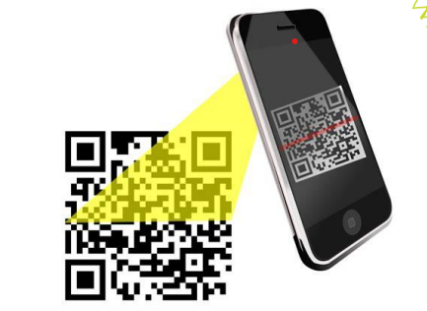
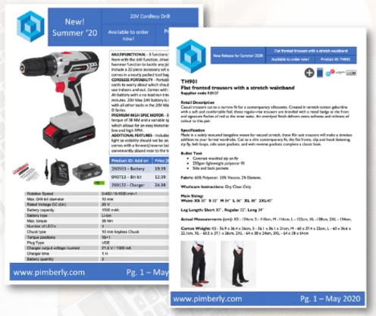
Digital Product Passport (Regulatory)
DPP: A set of machine-readable data accessed through a (persistent) product unique identifier, embedded in a data carrier and relying on an online look-up mechanism.
A sort of “e-label” or “e-datasheet” for products enabling
long-term access to information
NOT a tracking and tracing tool
Will NOT require revealing sensitive
supply-chain information

Slide 4
What are CIRPASS and CIRPASS-2 ?
Funded by the European Commission under the Digital Europe Programme
Duration: 18 months (from Oct 2022 to March 2024)
Coordination and Support Action
2M euros funding
31 partners
Funded by the European Commission under the Digital Europe Programme
Duration: May 2024 – April 2027​
Innovation Deployment Action​
6M euros funding
50 partners
Build consensus on a standards-based DPP system
Deploy at scale Digital Product Passports in four target value chains​ and demonstrate data-enabled B2B activities that promote circularity

Slide 5
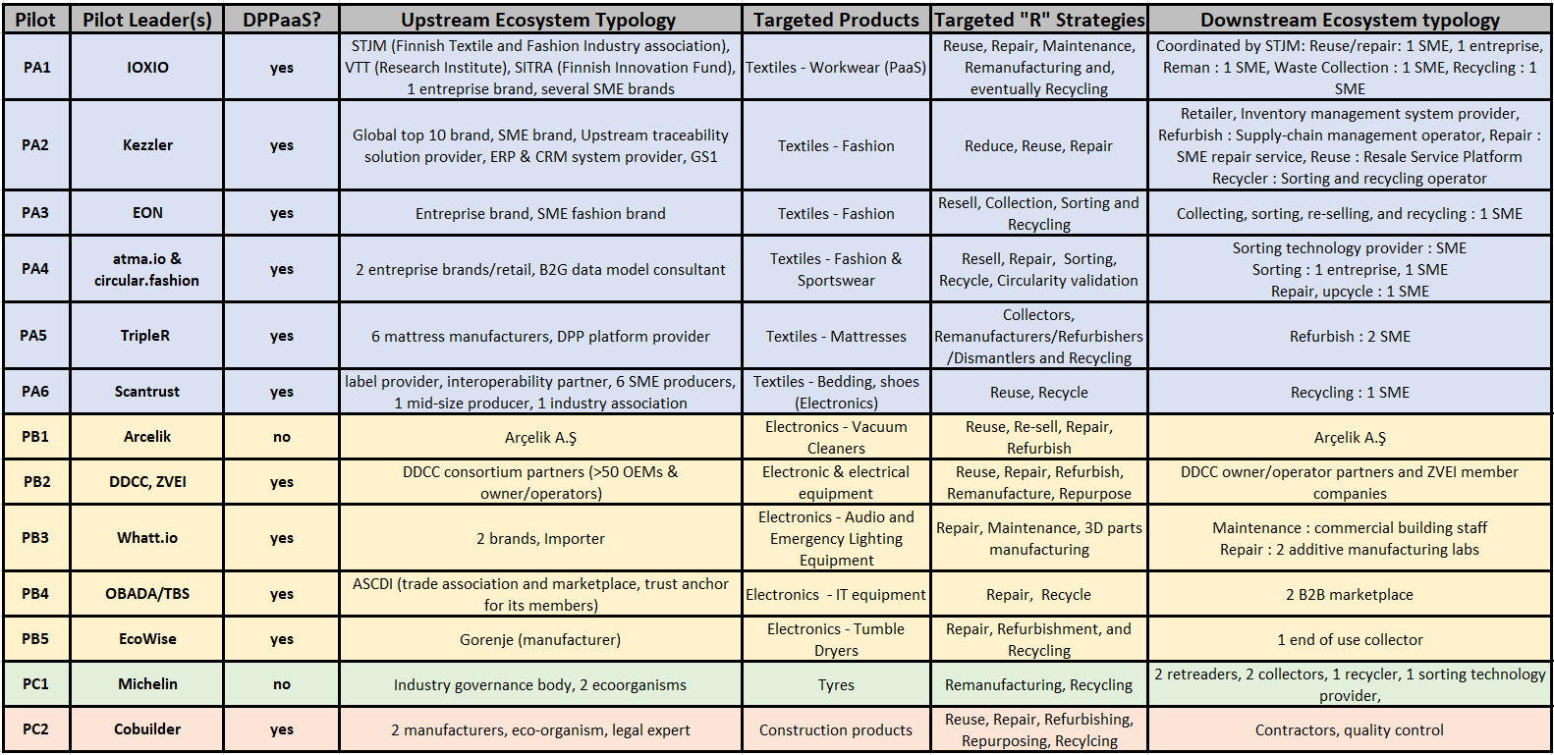
CIRPASS-2 Lighthouse Pilot Ecosystems (13)
For more information please visit: https://cirpass2.eu/lighthouse-pilots/

Slide 6
CIRPASS-2 Main objectives​
At scale and real-life deployments of Digital Product Passports:
All pilots must demonstrate B2B activities that promote circularity​ and provide quantitative proof of DPP ‘value’ (both economic and environmental).
Propose a DPP system architecture that is simultaneously aligned and interoperable with:
1 - the requirements of the Ecodesign for Sustainable Product Regulations (ESPR)
2 - the beyond-regulatory needs of industry, and
3 – international DPP initiatives.
Notes:
This slide shows the 4 main objectives of CIRPASS-2. Some comments:
1. All CIRPASS-2 pilots will demonstrate data-enabled circular activity in four different sectors, especially in B2B settings.
2. Objective 2 is especially ambitious and rarely addressed in DPP pilot projects.
3. We believe that low-cost DPP-as-a-Service solutions will be especially important for SMEs. Please refer to « A study on DPP costs and benefits for SMEs” available here https://cirpassproject.eu/project-results/
4. Self explanatory. Will be the specific focus of EWG5.

Slide 7
Why is the DPP System an incredible opportunity?
Vision: The DPP links the EU internal market to the data economy.
Based on standardised data exchange protocols
Containing sector-specific mandatory sustainability & circularity information
Mandatory
EU DPP

Slide 8
Why is the DPP System an incredible opportunity?
Vision: The DPP links the EU internal market to the data economy.
Food
Nuclear
Cables
Military
Composites
H₂ Electrolizers
Pumps
…
Connection to Manufacturing & Green Deal Data Spaces
The DPP is not just a regulatory tool.
Use of DPP in non-regulated sectors
Digitalisation tools for EU industry
Based on standardised data exchange protocols
Containing sector-specific mandatory sustainability & circularity information
Materials Passports
Mandatory
DPP onboarding: Data reuse
Data-enabled circular business models, beyond regulation
DPP for quality & certification
Related Digital technologies (IoT, DLT, VC, DIDs, Digital Twins, AI, …)
DPP & supply-chain ESG traceability tools
EU DPP
Real-time DPPs
Ontologies related to the DPP (e.g. LCA)
Non mandatory
EU DPP vs. international DPPs
Customs & DPP

Slide 9
Why is the DPP System an incredible opportunity?
Vision: The DPP links the EU internal market to the data economy.
Food
Nuclear
Cables
Military
Composites
H₂ Electrolizers
Pumps
…
Connection to Manufacturing & Green Deal Data Spaces
The DPP is not just a regulatory tool.
Use of DPP in non-regulated sectors
Digitalisation tools for EU industry
Based on standardised data exchange protocols
Containing sector-specific mandatory sustainability & circularity information
Materials Passports
Mandatory
DPP onboarding: Data reuse
Data-enabled circular business models, beyond regulation
The DPP standards solve one of industry’s biggest problems
→ too many different data sharing standards!
→ Too many data silos
DPP for quality & certification
Related Digital technologies (IoT, DLT, VC, DIDs, Digital Twins, AI, …)
DPP & supply-chain ESG traceability tools
EU DPP
Real-time DPPs
Ontologies related to the DPP (e.g. LCA)
Non mandatory
EU DPP vs. international DPPs
The DPP is basic digital infrastructure for EU industry.
Customs & DPP

Slide 10
Why is the DPP System an incredible opportunity?
Vision: The DPP links the EU internal market to the data economy.
Food
Nuclear
Cables
Military
Composites
H₂ Electrolizers
Pumps
…
Connection to Manufacturing & Green Deal Data Spaces
The DPP is not just a regulatory tool.
Use of DPP in non-regulated sectors
Digitalisation tools for EU industry
Based on standardised data exchange protocols
Containing sector-specific mandatory sustainability & circularity information
Materials Passports
Mandatory
DPP onboarding: Data reuse
Data-enabled circular business models, beyond regulation
The DPP standards solve one of industry’s biggest problems
→ too many different data sharing standards!
→ Too many data silos
DPP for quality & certification
Focus of CIRPASS-2
Related Digital technologies (IoT, DLT, VC, DIDs, Digital Twins, AI, …)
DPP & supply-chain ESG traceability tools
EU DPP
Real-time DPPs
Ontologies related to the DPP (e.g. LCA)
Non mandatory
EU DPP vs. international DPPs
The DPP is basic digital infrastructure for EU industry.
Customs & DPP

Slide 11
CIRPASS-2 Main objectives​
At scale and real-life deployments of Digital Product Passports:
All pilots must demonstrate B2B activities that promote circularity​ and provide quantitative proof of DPP ‘value’ (both economic and environmental).
Propose a DPP system architecture that is simultaneously aligned and interoperable with:
1 - the requirements of the Ecodesign for Sustainable Product Regulations (ESPR)
2 - the beyond-regulatory needs of industry, and
3 – international DPP initiatives.
HOW CAN WE ACHIEVE THIS?
Notes:
This slide shows the 4 main objectives of CIRPASS-2. Some comments:
1. All CIRPASS-2 pilots will demonstrate data-enabled circular activity in four different sectors, especially in B2B settings.
2. Objective 2 is especially ambitious and rarely addressed in DPP pilot projects.
3. We believe that low-cost DPP-as-a-Service solutions will be especially important for SMEs. Please refer to « A study on DPP costs and benefits for SMEs” available here https://cirpassproject.eu/project-results/
4. Self explanatory. Will be the specific focus of EWG5.

Slide 12
What is semantic interoperability?
Wikipedia: Semantic interoperability is the ability of computer systems to exchange data with unambiguous, shared meaning. ... This is accomplished by adding data about the data (metadata), linking each data element to a controlled, shared vocabulary. The meaning of the data is transmitted with the data itself, in one self-describing "information package" that is independent of any information system.
Meaning: Vocabularies, data models/ontologies, reference data
Semantic Interoperability
Syntactical Interoperability
Formats and structure
European Commission, Semantic Interoperability Courses, Module 1 – Introduction and overview of existing initiatives, ISA Programme, Action 1.1
https://joinup.ec.europa.eu/sites/default/files/document/2014-06/Semantic%20interoperability%20courses%20-%20Training%20Module%201%20-%20Introductory%20overview_v0.19.pdf

Slide 13
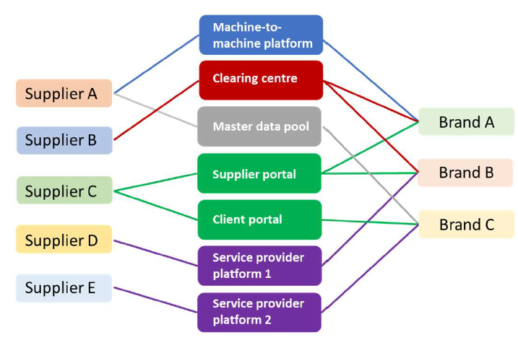
The problem with semantics – part 1
Term translation complexity
Supplier 1
Customer 1
Supplier 2
Customer 2
Supplier 3
Customer 3
Supplier 4
Customer 4

Slide 14
The problem with semantics – part 1
Term translation complexity
Semantic mapping complexity
Supplier 1
Customer 1
Supplier 1
Customer 1
Supplier 2
Customer 2
Supplier 2
Customer 2
Semantic anchor
Supplier 3
Customer 3
Supplier 3
Customer 3
Supplier 4
Customer 4
Supplier 4
Customer 4
DPP System “Core” Ontology

Slide 15
The problem with semantics – part 2
Unification – Everyone uses the same
Semantically interoperable anchors
Supplier 1
Customer 1
Supplier 1
Customer 1
Supplier 2
Customer 2
Supplier 2
Customer 2
Semantic anchor
Semantic anchor(s)
Semantic anchor
Semantic anchor
Supplier 3
Customer 3
Supplier 3
Customer 3
Supplier 4
Customer 4
Supplier 4
Customer 4
Results in standardisation wars: “My data model/semantics/classification/dictionary/taxonomy etc. standard is better than yours.”

Slide 16
Semantic interoperability vs. Unification
My product is red…
My information system:
Your information system:
"rouge"
→ Maps to →
"red"
"Cherry red"
Is a
Is a
Has name
"Luminous red"
color
color
Has name
Is the same as
Defined in
Has value
13-1023
Defined in
3024
Has value
Color system
Has name
Color system
Pantone
Has name
RAL

Slide 17
Why is semantic interoperability needed for the DPP system ?
Answer: REUSE
 | Effort (time)
Developing a data model (local to one information system) | + +
Developing a data model for an industrial ecosystem | + + +
Developing dictionaries, classification systems | + + + +
Developing a domain ontology (concepts, relations) | + + + +
Developing standards for information points (product carbon footprint, durability, …) | + + + +
Converting the above into machine readable formats | +
Making machine readable data semantically interoperable | +
An ontology is a formal representation of knowledge for a given domain. They can also be defined as data models with a standardized technical representation.

Slide 18
Why is semantic interoperability needed for the DPP system ?
1/ REUSE. Everyone can use their own.
2/ Avoid standardization wars.
3/ Promote interoperability with international DPPs.
4/ Break sectoral information barriers for a Circular Economy
5/ Support interoperability with other data pools (e.g. in-house IT systems, manufacturing data spaces, etc.) for beyond-mandatory DPP uses.
6/ Facilitate DPP extensibility for evolving information requirements

Slide 20
Term translation vs. Semantic mapping
Term translation:
Company A: “Product Code”
“5084c9gh"
→ translates to →
Company B:
“Item identifier"
“064RT"
Semantic mapping:
Name
Has value
“Product Code”
Product
Has granularity
Model
Has a
identifier
Encoding
Has value
“5084c9gh"
Name
Has value
“Item identifier"
Product
Has granularity
Model
Has a
identifier
Encoding
Has value
“064RT"

Slide 21
Term translation vs. Semantic mapping
Term translation:
Company A: “Product Code”
“5084c9gh"
→ translates to →
Company B:
“Item identifier"
“064RT"
Semantic mapping:
Name
Has value
“Product Code”
Product
Has granularity
Model
Has a
identifier
Encoding
Has value
“5084c9gh"
If the product is the same, then semantic mappings can be applied automatically.
Name
Has value
“Item identifier"
Product
Has granularity
Model
Has a
identifier
Encoding
Has value
“064RT"

Slide 22
Term translation vs. Semantic mapping
Term translation:
Company A: “Product Code”
“5084c9gh"
→ translates to →
Company B:
“Item identifier"
“064RT"
Semantic mapping:
Name
Has value
“Product Code”
Product
Has granularity
Model
Has a
identifier
Encoding
Has value
“5084c9gh"
If the product is the same, then semantic mappings can be applied automatically.
Name
Has value
“Item identifier"
Product
Has granularity
Model
Has a
identifier
Encoding
Has value
“064RT"
Semantic interoperability requires transporting the metadata (i.e. the semantics) with the data!

